Slide 1

Mobile Application Development
with ANDROIDd

Slide 2
Introduction
What is Android?
  A software platform and operating system for mobile devices
  Based on the Linux kernel
  Developed by Google and later the Open Handset Alliance (OHA)
  Allows writing managed code in the Java language
  Unveiling of the Android platform was announced on 5 November 2007 with the founding of OHA

Slide 3
History of Android
Google acquired the startup company Android Inc. in 2005 to start the development of the Android Platform. The key players at Android Inc. included Andy Rubin, Rich Miner, Nick Sears, and Chris White.
In late 2007, a group of industry leaders came together around the Android Platform to form the Open Handset Alliance (http://www.openhandsetalliance.com).
The Android SDK was first issued as an “early look” release in November 2007.
In September 2008 T-Mobile announced the availability of the T-Mobile G1, the first smartphone based on the Android Platform.
A few days after that, Google announced the availability of Android SDK Release Candidate 1.0.
In October 2008, Google made the source code of the Android Platform available under Apache’s open source license.

Slide 4
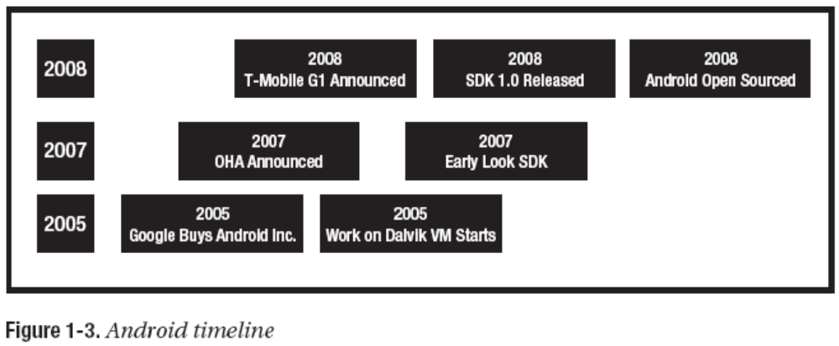
History of Android

Slide 5
What is Open Handset Alliance?
Quoting from www.OpenHandsetAlliance.com page
“… Open Handset Alliance™, a group of 47 technology and mobile companies have come together to accelerate innovation in mobile and offer consumers a richer, less expensive, and better mobile experience.
Together we have developed Android™, the first complete, open, and free mobile platform.
We are committed to commercially deploy handsets and services using the Android Platform. “

Slide 6
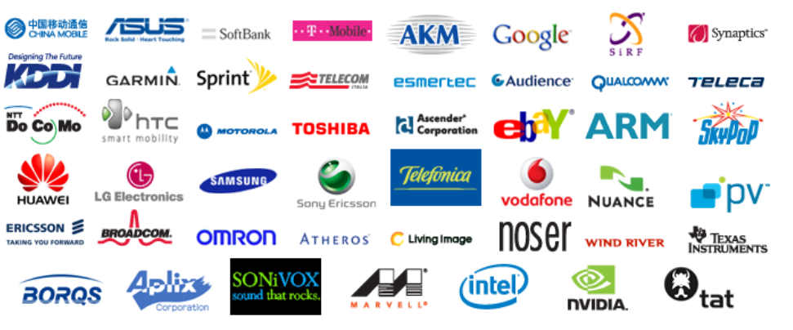
Introduction
What is the Open Handset Alliance (OHA)?
  → It's a consortium of several companies
Google Android

Slide 7
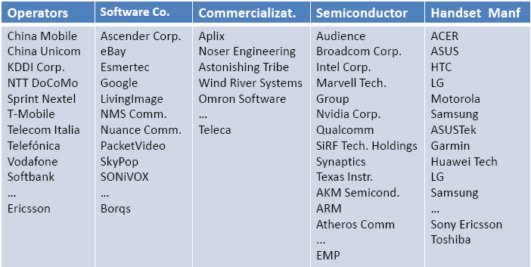

Open Handset Alliance Members

Slide 8
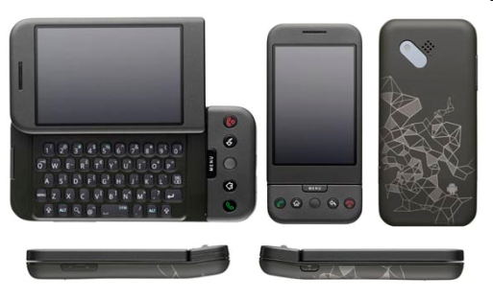
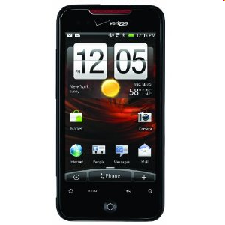
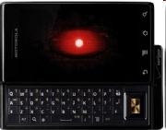
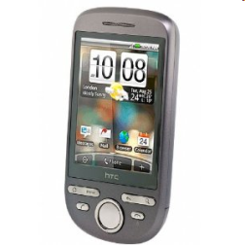
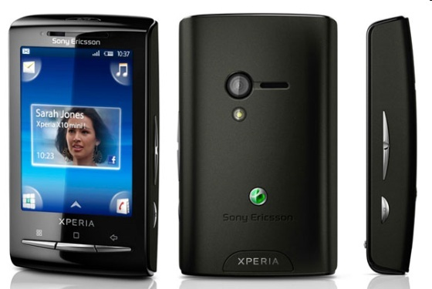
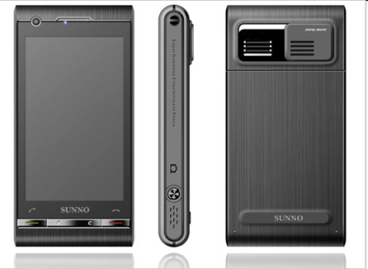
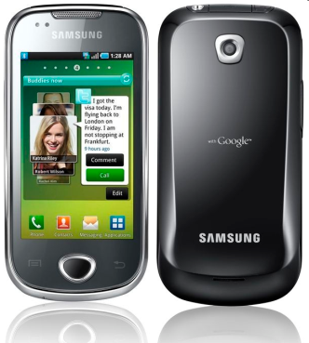
Phones
HTC G1,
Droid,
Tattoo
Motorola Droid (X)
Suno S880
Samsung Galaxy
Sony Ericsson
@2010 Mihail L. Sichitiu

Slide 9
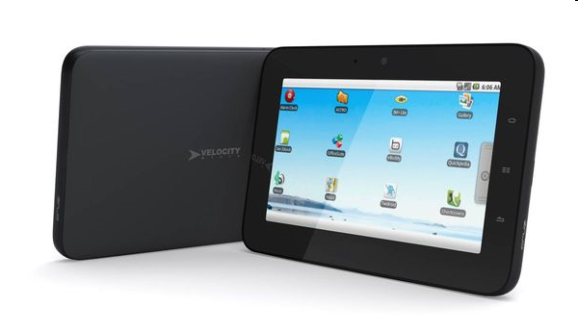
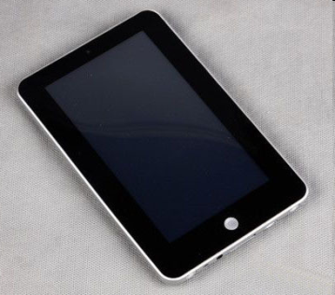
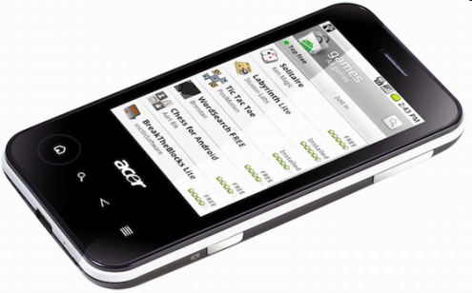
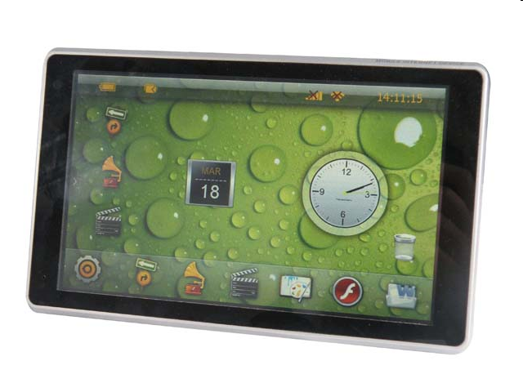
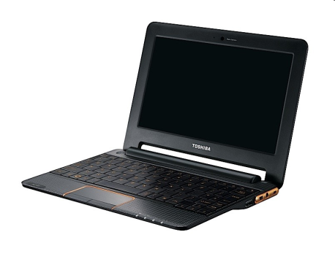
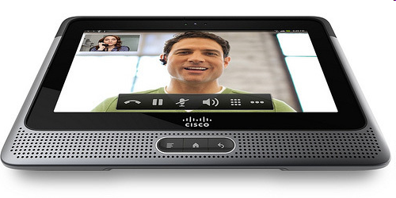
Tablets
Velocity Micro Cruz
Gome FlyTouch
Acer beTouch
Toshiba Android
SmartBook
Cisco Android Tablet
Dawa D7
@2010 Mihail L. Sichitiu

Slide 10
Platform
Hardware
Android is not a single piece of hardware; it's a complete, end-to-end software platform that can be adapted to work on any number of hardware configurations. Everything is there, from the bootloader all the way up to the applications.
Google Android

Slide 11
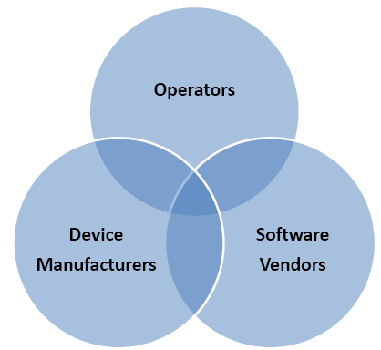
Android’s Context: Mobile Market Player$
Stakeholders:
Mobile network operators want to lock down their networks, controlling and metering traffic.
Device manufacturers want to differentiate themselves with features, reliability, and price points.
Software vendors want complete access to the hardware to deliver cutting-edge applications.

Slide 12
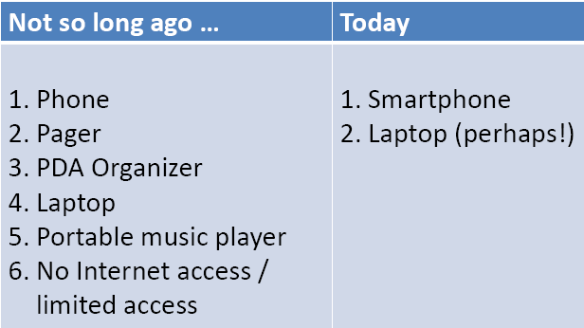
The Maturing Mobile Experience
Tomorrow?

Slide 13
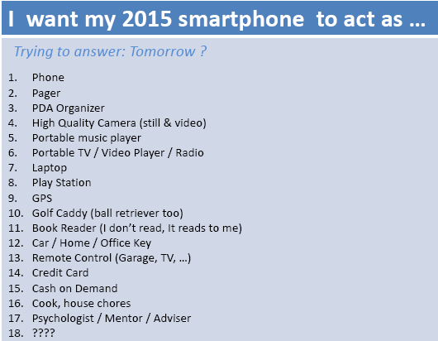
The Maturing Mobile Experience

Slide 14
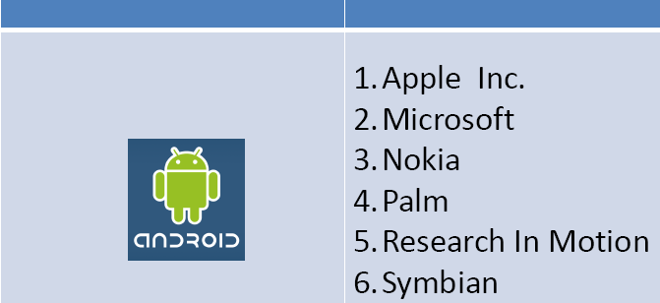
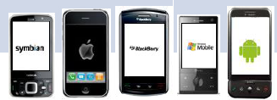
Android vs. Competitors

Slide 15
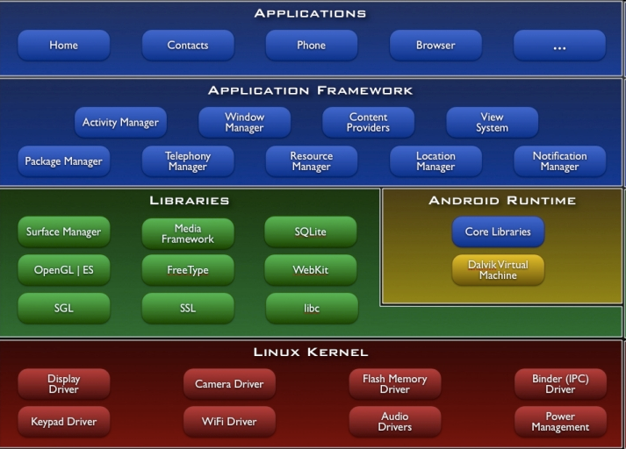
Platform - The Android Software Stack
@2010 Mihail L. Sichitiu

Slide 16

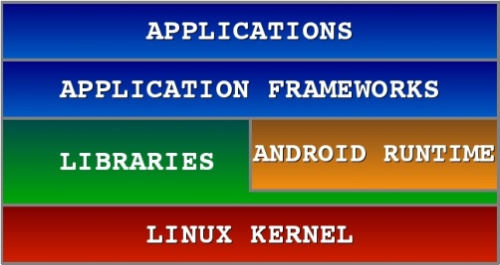
Android S/W Stack - Application
Android provides a set of core applications:
  Email Client
  SMS Program
  Calendar
  Maps
  Browser
  Contacts
  Etc
All applications are written using the Java language.
@2010 Mihail L. Sichitiu

Slide 17
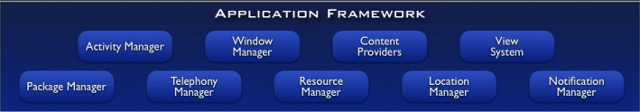
Android S/W Stack – App Framework
Most of the application framework accesses these core libraries through the Dalvik VM, the gateway to the Android Platform
@2010 Mihail L. Sichitiu

Slide 18
Android S/W Stack –
App Framework (Cont)
Feature | Role
View System | Used to build an application, including lists, grids, text boxes, buttons, and embedded web browser
Content Provider | Enabling applications to access data from other applications or to share their own data
Resource Manager | Providing access to non-code resources (localized string , graphics, and layout files)
Notification Manager | Enabling all applications to display customer alerts in the status bar
Activity Manager | Managing the lifecycle of applications and providing a common navigation backstack
@2010 Mihail L. Sichitiu

Slide 19
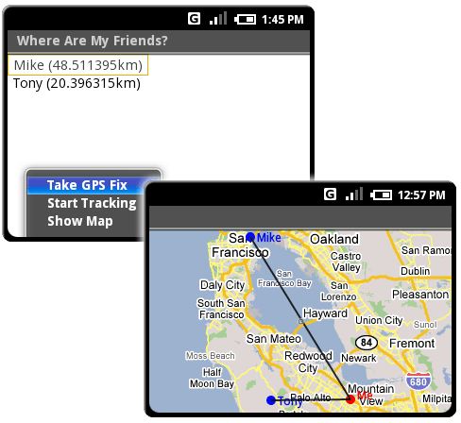
Location Manager

Slide 20
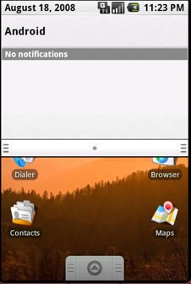
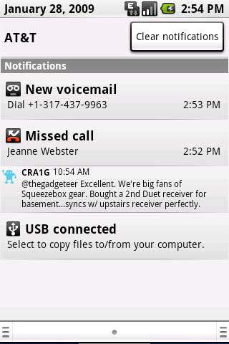
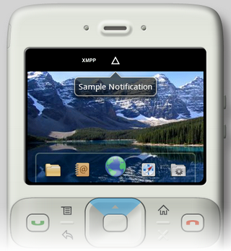
Notification Manager

Slide 21
Notification Manager
How background app interact with users
Consistent notification presentation

Slide 22
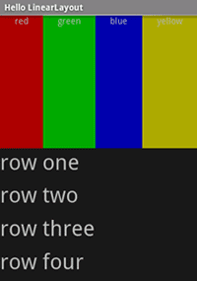
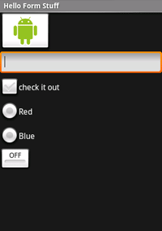
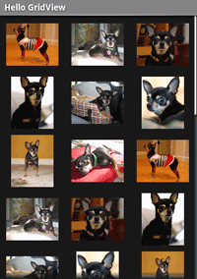
View System

Slide 23
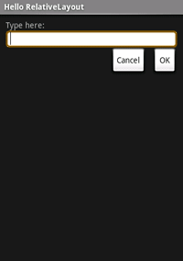
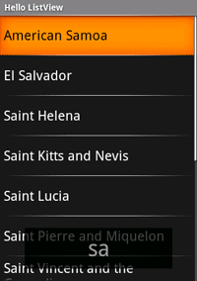
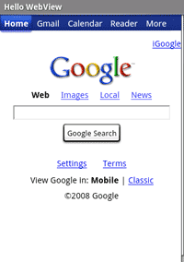
View System

Slide 24
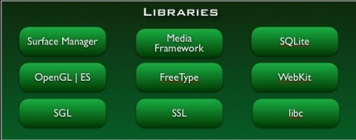
Android S/W Stack - Libraries
Including a set of C/C++ libraries used by components of the Android system
Exposed to developers through the Android application framework
@2010 Mihail L. Sichitiu

Slide 25
Android S/W Stack - Libraries
The media libraries are based on PacketVideo’s (http://www.packetvideo.com/) OpenCORE. These libraries are responsible for recording and playback of audio and video formats.
A library called Surface Manager controls access to the display system and supports 2D and 3D.
The WebKit library is responsible for browser support; it is the same library that supports Google Chrome and Apple Inc.’s Safari.
The FreeType library is responsible for font support.
SQLite (http://www.sqlite.org/) is a relational database that is available on the device itself. SQLite is also an independent open source effort for relational databases and not directly tied to Android. You can acquire and use tools meant for SQLite for Android databases as well.

Slide 26
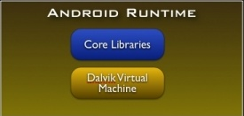
Android S/W Stack - Runtime
Core Libraries
  Providing most of the functionality available in the core libraries of the Java language
  APIs
    Data Structures
    Utilities
    File Access
    Network Access
    Graphics
    Etc
@2010 Mihail L. Sichitiu

Slide 27
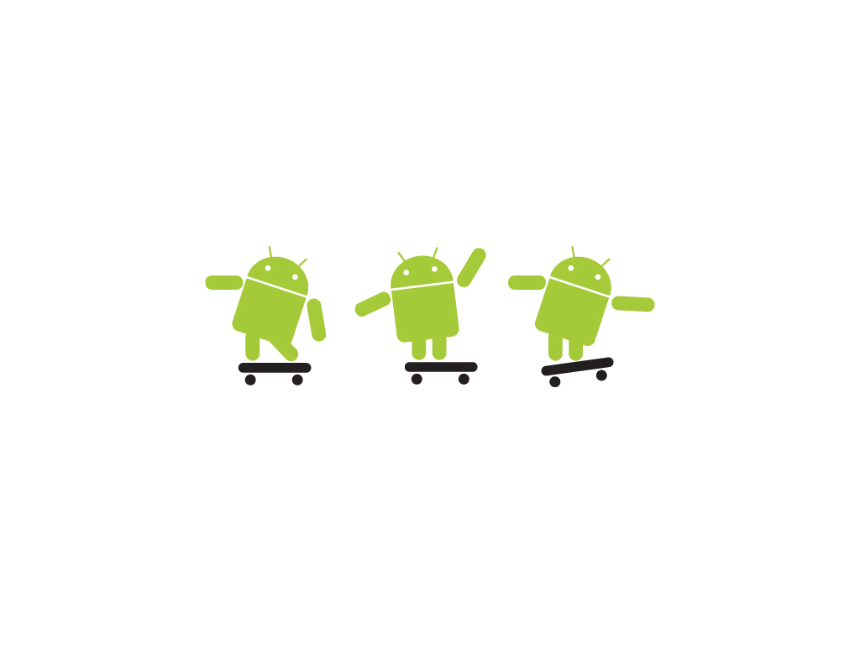
The Dalvik runtime is optimised for mobile applications
Run multiple VMs efficiently
Each app has its own VM
Minimal memory footprint
Bruce Scharlau, University of Aberdeen, 2010

Slide 28
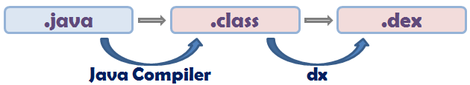
Android S/W Stack – Runtime (Cont)
Dalvik Virtual Machine (Cont)
  Executing the Dalvik Executable (.dex) format
    .dex format is optimized for minimal memory footprint.
    Compilation
  Relying on the Linux Kernel for:
    Threading
    Low-level memory management
@2010 Mihail L. Sichitiu

Slide 29
Android applications are compiled to Dalvik bytecode
Write app in Java
Compiled in Java
Transformed to Dalvik bytecode
Linux OS
Loaded into Dalvik VM
Bruce Scharlau, University of Aberdeen, 2010

Slide 30
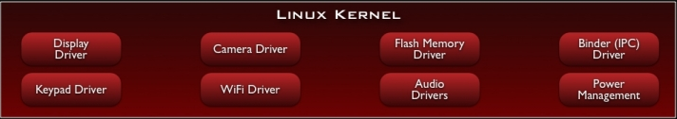
Android S/W Stack – Linux Kernel
Relying on Linux Kernel 2.6 for core system services
  Memory and Process Management
  Network Stack
  Driver Model
  Security
The supplied device drivers include Display, Camera, Keypad, WiFi, Flash Memory, Audio, and IPC (interprocess communication).
Providing an abstraction layer between the H/W and the rest of the S/W stack
@2010 Mihail L. Sichitiu

Slide 31
Platform
Network Connectivity
  It supports wireless communications using:
    GSM mobile-phone technology
    3G
    Edge
    802.11 Wi-Fi networks
Google Android

Slide 32
Software development
Development requirements
  Java
  Android SDK
Google Android

Slide 33
Software development
IDE and Tools
Android SDK
  Class Library
  Developer Tools
  Emulator and System Images
  Documentation and Sample Code
Eclipse IDE + ADT (Android Development Tools)
  Reduces Development and Testing Time
  Makes User Interface-Creation easier
  Makes Application Description Easier
Google Android

Slide 34
Advantages
Here are a few other advantages Android offers you as a developer:
The Android SDK is available for Windows, Mac and Linux, so you don’t need to pay for new hardware to start writing applications.
An SDK built on Java. If you’re familiar with the Java programming language, you’re already halfway there.
By distributing your application on Android Market, it’s available to hundreds of thousands of users instantly. You’re not just limited to one store, because there are alternatives, too. For instance, you can release your application on your own blog. Amazon have recently been rumoured to be preparing their own Android app store also.
As well as the technical SDK documentation, new resources are being published for Android developers as the platform gains popularity among both users and developers.
Google Android

Slide 35
Application Building Blocks
Activity
IntentReceiver
Service
ContentProvider

Slide 36
Activities
Typically correspond to one UI screen
But, they can:
  Be faceless
  Be in a floating window
  Return a value

Slide 37
IntentReceivers
Components that respond to broadcast ‘Intents’
Way to respond to external notification or alarms
Apps can invent and broadcast their own Intent

Slide 38
Intents
Think of Intents as a verb and object; a description of what you want done
  E.g. VIEW, CALL, PLAY etc..
System matches Intent with Activity that can best provide the service
Activities and IntentReceivers describe what Intents they can service

Slide 39









Intents
Photo Gallery
Home
Picasa
Contacts
“Pick photo”
GMail
Chat
Blogger
Blogger

Slide 40
Services
Faceless components that run in the background
  E.g. music player, network download etc…

Slide 41
ContentProviders
Enables sharing of data across applications
  E.g. address book, photo gallery
Provides uniform APIs for:
  querying
  delete, update and insert.
Content is represented by URI and MIME type

